Slide 1
Welcome!
Round of Introductions
Our Moderator: Kimia Ziafat
You All: Welcome and please learn alongside us
Speaker/Myself: Verena Langheimer
If you like, please introduce yourself in the CHAT box!
We would like to hear who you are and other things that you would like to share with us!

Slide 2
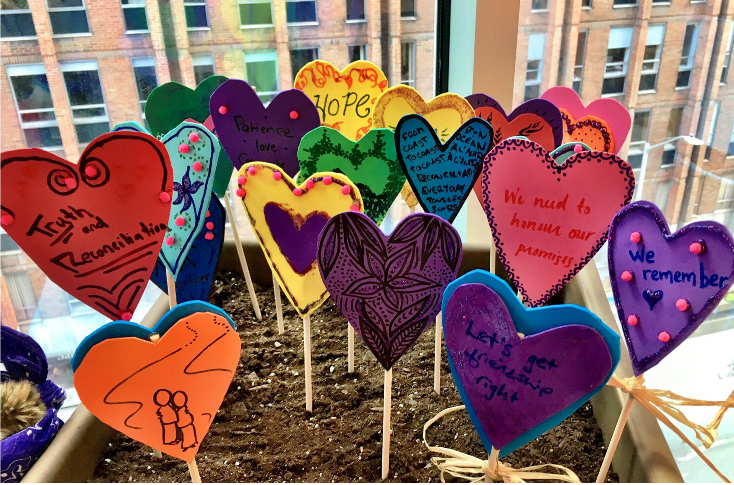
Child Welfare and Homelessness
Research, results and recommendations from the BC Health of the Homeless Survey

Slide 3
Acknowledgement
I respectfully acknowledge that I live, play, and work on valued ancestral, traditional and unceded Indigenous territories, including the territories of the Sḵwx̱wú7mesh (Squamish), səl̓ilwətaɁɬ (Tsleil-Waututh), and xʷməθkʷəy̓əm (Musqueam) First Nations.
No Disclosures.

Slide 4
Overview
I. Background Research
Describe child welfare in Canada and BC
Describe the relationships between child welfare, homelessness and indicators of health (as much as we know it)
II. Results from the BCHOHS
Descriptive and correlated statistics
III. Pathways Forward
Conclusion from the BCHOHS and opportunities for positive change
Summary of the current evidence base
Ongoing innovative programming and research

Slide 5
“Child welfare” is a term used to describe a set of government and private services designed to protect children and encourage family stability. The main aim of these services is to safeguard children from abuse and neglect. Child welfare agencies will typically investigate allegations of abuse and neglect, supervise foster care and arrange adoptions. They also offer services aimed to support families so that they can stay intact and raise children successfully.”
-Canadian Child Welfare Research Portal: http://www.cwrp.ca

Slide 6
SLIDO Poll: Child Welfare System
If you have any experience with the Child Welfare System, how would you describe your experience with this system?

Slide 7
Child Welfare in Canada
67,000 children in care in Canada in 2007¹
Aboriginal youth are overrepresented
Capacity needs are changing
Between the year 1990-2000²:
Children needing out of home placement
Health needs of children
Length of stay in foster care
Proportion of children in Group care or residential care
Number of placement resources
1. Mulcany and Trocme, 2010; 2. Child Welfare League of Canada, 2002
Notes:
2008: 88, 000: an increase of 52% in ten years.
Issue of capacity

Slide 8
9, 271
(1% of total B.C. pop.)
Notes:
+ 39% Aboriginal

Slide 9
9, 271
(1% of total B.C. pop.)
-28%
Notes:
+ 39% Aboriginal

Slide 10
9, 271
(1% of total B.C. pop.)
-28%
+39%
Notes:
+ 39% Aboriginal

Slide 11
Section 88 (1951) of the Indian Act amended. Responsibility for First Nation’s health, welfare and eduction transferred from the federal to the provincial government.
Notes:
Indian and Northern Affairs Canada (on-reserve children placed in care)

Slide 12
CHAT BOX: Share your thoughts!
What do you think contributes to the increase in children of aboriginal heritage in care in light of the decrease in the total number of children in care?

Slide 13
Figure 3: Changes in number of children in care, foster care families available and related community agencies in British Columbia between 2000-2006³
Total Children in Care (-9%)
Foster Care Homes Available
(-23%)
Community Supports Available
(-23%)
³ BC Association of Social Workers

Slide 14
Figure 3: Changes in number of children in care, foster care families available and related community agencies in British Columbia between 2000-2006³
Total Children in Care (-9%)
Foster Care Homes Available
(-23%)
Community Supports Available
(-23%)
Non-Aboriginal Children in Care
(-21%)
³ BC Association of Social Workers

Slide 15
Figure 3: Changes in number of children in care, foster care families available and related community agencies in British Columbia between 2000-2006³
Aboriginal Children in Care
(+24%)
Total Children in Care (-9%)
Foster Care Homes Available
(-23%)
Community Supports Available
(-23%)
Non-Aboriginal Children in Care
(-21%)
³ BC Association of Social Workers
Notes:
Critical resource deficit for Aboriginal children

Slide 16
CHAT BOX: Share your thoughts!
There is a decrease of available foster homes and a decrease of available community supports. What could this mean to children who ‘need’ foster care?

Slide 17
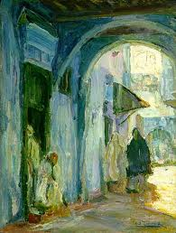
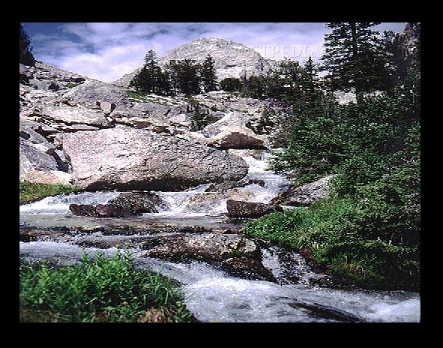
Exploring the Relationships Between Child Welfare and Homelessness
“Is foster care a gateway to the streets?”
“The intersecting streams of homelessness...”
Notes:
Certainly there are many aspects to the relationship between Child Welfare and Homelessness and I’m going to focus on some of them

Slide 18
Child Welfare and Homelessness
Figure 4: Prevalence of Child Welfare experience among different street populations
Relationship #1: Homeless people are much more likely than housed people to have been in the child welfare system (Caution: these are low ranging numbers)
1998 1999
1993 1995 1997 1999 1999 2005

Slide 19
Child Welfare and Homelessness
Figure 5: Pathways of association between the Child Welfare system and homelessness
Relationship #2: Many youth who leave the system end up homeless within 2 years
Foster care/Group home
15-22% experienced homelessness within 1 year³⁻⁴
53% were either homeless or unstably housed within 18 months³
43% had housing problems within 2 years⁵
21-63% had been in foster care¹⁻²
Street
Youth
Homeless
Adults
20-39% had been in foster care⁶
1. Ensign, 1998; 2. Green, 1999; 3. Kushel, 2007; 4. Pecora, 2006; 5. Zlotnick; 6. See slide 15
Notes:
Although the latter have sometimes been interpreted as showing that a history of out of-home care placement increases the risk of homelessness, that conclusion is generally not justified (Piliavin et al., 1993).
Instability in housing associated with number of placements, emotional disturbances, victimization

Slide 20
Child Welfare, Homelessness,
Mental Health and Maltreatment
In BC 65% of children in care have been diagnosed with a MHD vs. 17% in the community¹⁰
Mental Health
54-67% mental disorder, high % of concurrent disorder¹¹⁻¹⁴
Child Welfare
Homelessness
Relationship #3: Homeless people and youth in care experience similarly high rates of mental health issues, maltreatment and trauma
9. Steele, 2008; 10. Child and Youth Officer, 2006; Richardson, 2007; Stein, 1994; North, 1993; Lehman, 1993; Vasquez, 1997. Koegel, 1988
Notes:
Higher psychopathology than other economically disadvantaged children (Husley, 1989, in Pilowski, 1995)
60% substance use disorder ¹¹⁻¹⁴

Slide 21
Child Welfare, Homelessness,
Mental Health and Maltreatment
In BC 65% of children in care have been diagnosed with a MHD vs. 17% in the community¹⁰
Mental Health
54-67% mental disorder, high % of concurrent disorder¹¹⁻¹⁴
Child Welfare
Homelessness
Early childhood abuse and neglect
50% of ‘runaways’ physically abused¹⁵
30% sexually abused
Past victimization^{16,17}
Early childhood trauma¹⁸
30% sexually or physically assaulted¹⁶
Childhood Maltreatment/
Childhood Trauma
9. Steele, 2008; 10. Child and Youth Officer, 2006; Richardson, 2007; Stein, 1994; North, 1993; Lehman, 1993; Vasquez, 1997. Koegel, 1988; 15 Tyler, 2002; 16. Kushel, 2003; 17. Stein, 2002; Shelton, 2009
Notes:
Higher psychopathology than other economically disadvantaged children (Husley, 1989, in Pilowski, 1995)
Zlotnick: housing instability was related to emotional and behavioural problems, physical and sexual victimizations

Slide 22
Child Welfare and Homelessness
Figure 6: The intergenerational effect
1st generation
2nd generation
3rd generation...
Homelessness
Homelessness
Homelessness
Child Welfare
Child Welfare
50% of children in care had parents who had experienced homelessness⁷
15% of minor aged children were living with their homeless parents⁸
More likely to lose children to the foster care system
Relationship #4: Child welfare and homelessness can be a cyclical experience that spans generations
7. Zlotnik, 1998; 8. Zlotnick, 2009
Notes:
The cyclical nature of homelessness

Slide 23
CHAT BOX: This is so complicated! Help me out here!
There are many theories about the intersection about homelessness, mental health, foster care/children in care, intergenerational effects, and trauma (and many more factors…)
How to even start solving all this?
How to even start thinking about all this?

Slide 24
II. BC Health of the Homeless Survey Results
The Child Welfare experience in the BCHOHS
Age first in care: 8.8 years; sd=5.8
Median number of transitions: 3
Placed in both a foster family and a group home: 42%
Only one placement: 38%

Slide 25
II. BC Health of the Homeless Survey Results
Figure 7: Prevalence of Child Welfare experience among homeless samples survey and participants (n=500)
46%
39%
20%
BCHOHS Homeless Studiesª
Notes:
Participants (n=500: Van=250; Vic=150; PG=100)
Age: 37.9 years (mean)
Gender: 63% male; 37% female
Ethnicity: 64% white; 30% Aboriginal; 6% other
Current sleeping situation: 50% street; 50% shelter
Education: 64% had not completed high school

Slide 26
II. BC Health of the Homeless Survey Results
Figure 8: Prevalence of Child Welfare experience among homeless samples survey and participants by heritage (n=500)
70%
46%
20-39%
29%

Slide 27
II. BC Health of the Homeless Survey Results
Summary of results - Depending on time I will share details
46% of all homeless British Columbians surveyed and 70% of Aboriginal participants had been in the child welfare system
When compared to those who had not been in care, participants who reported a history of being in the child welfare system had a:
burden of mental disorder and substance use
burden of physical conditions
burden of childhood trauma and adult abuse

Slide 28
II. BC Health of the Homeless Survey Results
Table 1: Demographic comparison between participants who had been in the child welfare system (n=228) and those who had not (n=272)
Variable | Child Welfare | No Child Welfare
Median age at baseline** | 35 years | 41 years
Aboriginal** | 61.4% | 21.7%
Female gender* | 46.5% | 33.1%
No High School Dip.** | 71.9% | 56.6%
Ever Incarcerated** | 76.8% | 56.3%
Parent in child welfare** | 16.2% | 7%
*p<0.05; ** P<0.001

Slide 29
Table 2: Mental health disorder comparison between participants who had been in the child welfare system (n=228) and those who had not (n=272)
Mental Disorder | Child Welfare | No Child Welfare
Current substance use dependence | 70% | 70%
Agoraphobia* | 34% | 24%
Current alcohol dependence* | 44% | 32%
Suicide attempt** | 45% | 31%
Current adult ADD* | 35% | 26%
Current PTSD* | 25% | 17%
Current major depressive episode | 23% | 22%
Current Psychosis | 16% | 14%
*p<0.05; ** P<0.001

Slide 30
Figure 9: Substance use severity comparison between participants who had been in the child welfare system (n=228) and those who had not (n=272)
*p<0.05

Slide 31
Figure 11: Childhood trauma and adult abuse comparison between participants who had been in the child welfare system (n=228) and those who had not (n=272)
*p<0.05; ** P<0.001
Notes:
Homeless women who reported CSA 4X more likely to be sexually abuse

Slide 32
Figure 11: Childhood trauma and adult abuse comparison between participants who had been in the child welfare system (n=228) and those who had not (n=272)
*p<0.05; ** P<0.001
Notes:
Homeless women who reported CSA 4X more likely to be sexually abuse

Slide 33
(if time)CHAT BOX: British Columbia’s numbers seem worse…
What do you think contributes in British Columbia to the high/higher rates of detrimental outcomes of children in care and homeless people?
(versus other rates of studies from the US/CAN)

Slide 34
III. Pathways Forward based on the BCHOHS
I. Implement and evaluate childhood trauma treatment and prevention programs for vulnerable populations
Support vulnerable families
Integrated in the community
Help meet unmet mental health care needs in the population
Multi-tiered programs that addresses mental health, addiction and trauma issues simultaneously

Slide 35
III. Pathways Forward based on the BCHOHS
II. Incorporate and evaluate mental health and trauma treatment programs in high priority youth settings, including:
Mental health and addiction support for children in care
On going support for foster parents that offer education and skill development in areas related to attachment, trust, attunement, trauma, non-violent communication, mental health and substance use
Programs and policies dedicated to and led by Aboriginal people
Transition programs for youth leaving care (Foster Care Independence Act, 1999)

Slide 36
III. The Way Forward: Current evidence base
What type of programs are needed:
Programs that are suitable for the population:
“meet youth where there at”
non-threatening
non-stigmatizing
Evidence based programming that reflects the inter-relationship between many of the major issues confronting youth, by simultaneously addressing:
mental health
addiction
trauma
trust
attachment
Notes:
For some street youth, leaving home was an important step in the way of taking care of themselves. Also many youth demonstrate the will to move beyond street life.
Dialectical behaviour therapy may be useful

Slide 37
CHAT BOX: What does that even mean?
These recommendations are so unspecific, vague and I do not want to hear the empty phrase ‘meet the youth where they are at’ one more time. What does that even mean in real life?
Share your ideas, thoughts, (dreams)!

Slide 38
Thank you!

